Slide 1


2019.08.14
How to solve the low utilization rate of Alibaba business intelligence
CLASS-6
Mingyuan Zhu
Carl
2019040934

Slide 2
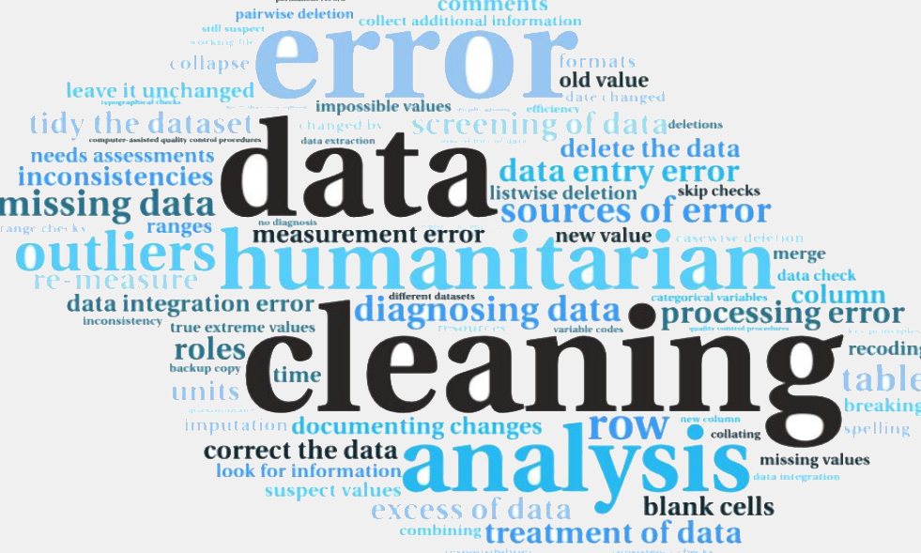

Low utilization
Background
▲ Little changed in business results （BI lack of impact ）
(Greenwood, 2017)
▲ Most time for unstructured data
(Delic and Riley, 2013; Maheshwari, 2015)
Overview
Problem
Solution
Conclusion
主体研究
Reference
Notes:
It’s a process like a pyramid, you input the data in your real business, then you analysis it, you present its feature behind the data by visualization, and finally this results effect on the results.

Slide 3
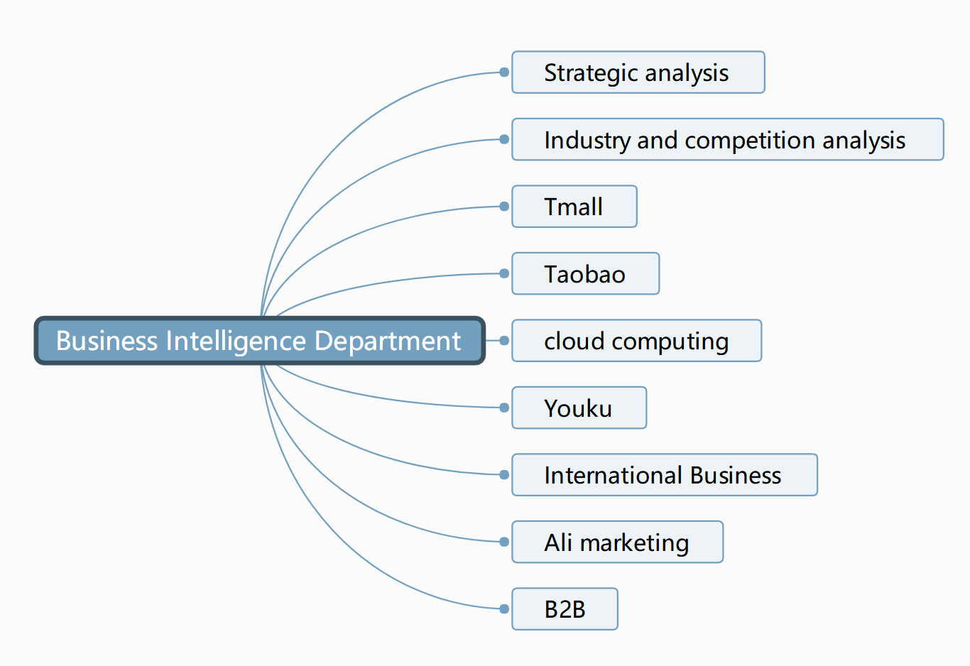
Business Intelligence Department
Background
Overview
Problem
Solution
Conclusion
主体研究
Reference
Notes:
This is a picture of one of the BI software, it looks easy, right? Just click the mouse, make some ppt and copy some picture from this software.

Slide 4
Overview
Background
Overview
▲ The problem of low utilization and Alibaba BI data
▲ The solution to the problems
▲ The evaluation of the solution
▲ Conclusion
Problem
Solution
Conclusion
主体研究
Reference

Slide 5
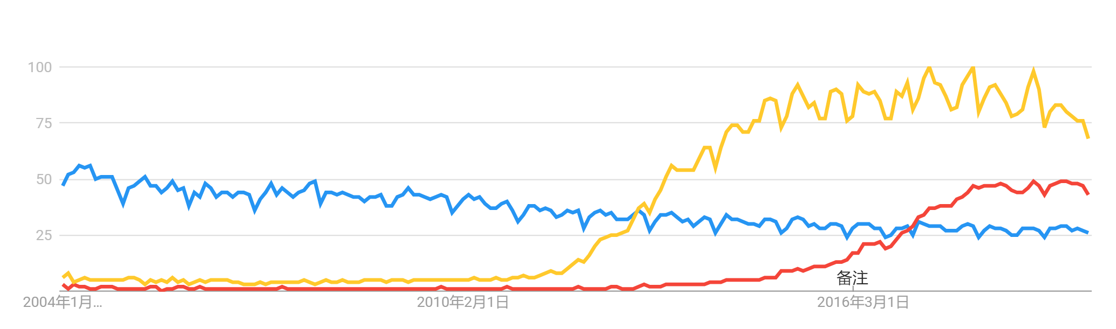



Problem 1: lack of impact
Background
Overview
▲ From Google searches
- BI decrease
(trends.google.com, 2012)
Problem
Solution
Conclusion
主体研究
Reference
Notes:
It’s a process like a pyramid, you input the data in your real business, then you analysis it, you present its feature behind the data by visualization, and finally this results effect on the results.

Slide 6
Problem 1: lack of impact
Background
Overview
Problem
Solution
主体研究
Conclusion
Reference
(Statista Research Department, 2019)
Notes:
Before 2016 Chinese people do not care about the important of data actually.

Slide 7
Solution1: Data Science for Everyone
Background
▲ Data scientist participant in decision making & executive accessible to the data
(Işık, Jones and Sidorova, 2012 )
+ SCIENTIFIC: Decision making scientific
- LACK TALENT: Hard to master both of them
Overview
Problem
Solution
Conclusion
主体研究
Reference
Notes:
It’s a process like a pyramid, you input the data in your real business, then you analysis it, you present its feature behind the data by visualization, and finally this results effect on the results.

Slide 8
Solution2 : Visualization
Background
Overview
Problem
▲ Present data in visuals ways: figure
X Not excel
(Işık, Jones and Sidorova, 2012 )
+ TRUST: Data is more trustworthy
- COST: Special tools | tableau- too expensive !!!
Solution
Conclusion
主体研究
Reference
Notes:
It’s a process like a pyramid, you input the data in your real business, then you analysis it, you present its feature behind the data by visualization, and finally this results effect on the results.
将数据做得越来越便捷，未来根本不应该有集中式的 BI 部门。数据应该回归本身，让所有人都可以分析，人人都可以成为数据分析师。不是说没有 BI 部门，而是说未来某天数据分析技能已经被每个业务人员掌握。

Slide 9
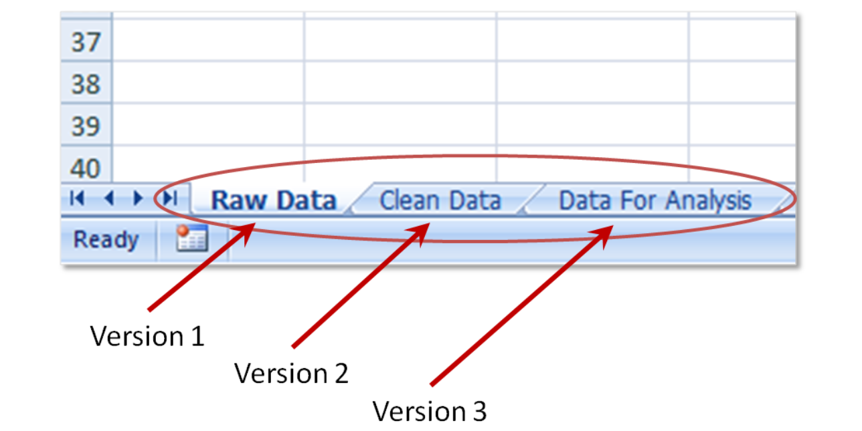
Problem 2: Unstructured data
Background
▲ Data more than one source(picture, voice, text..) for Alibaba’s business
▲ feature-> format(Corbitt,2003)
Overview
Problem
Solution
Conclusion
主体研究
Reference
Notes:
Like test, picture, and even the 0 and 1 data
在全域大数据的大潮之下，每家公司都要重新思考，当互联网的场景从单一的桌面转移到多源、多终端时，不仅会带来丰富的空间维度，还会增加更多从前匪夷所思的新场景所产生的数据。

Slide 10
Solution 3 Clean data effectively
Background
▲ Using mart BI remove unwanted observations (Greenwood, 2007; Ohlhorst, 2012)
▲ Packages in R and Python(Ganti and Das, 2013;Struhl, 2015)
+ EASY：follow the data clean task
(Greenwood‐Nimmo and Shields, 2017)
- NEW DESIGN: special toolkits
Overview
Problem
Solution
Conclusion
Reference
Notes:
Like test, picture, and even the 0 and 1 data
在全域大数据的大潮之下，每家公司都要重新思考，当互联网的场景从单一的桌面转移到多源、多终端时，不仅会带来丰富的空间维度，还会增加更多从前匪夷所思的新场景所产生的数据。

Slide 11
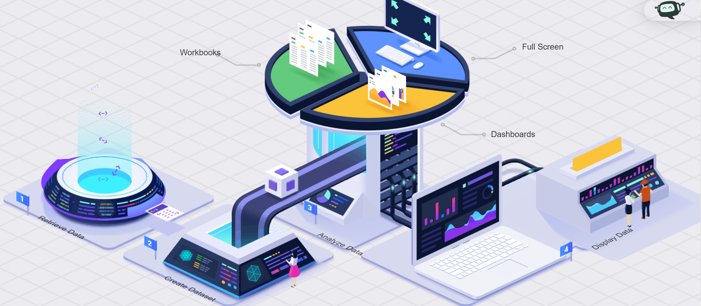
Solution 3 Clean data effectively
Background
Overview
Problem
Solution
Conclusion
主体研究
Reference
Notes:
Like test, picture, and even the 0 and 1 data
在全域大数据的大潮之下，每家公司都要重新思考，当互联网的场景从单一的桌面转移到多源、多终端时，不仅会带来丰富的空间维度，还会增加更多从前匪夷所思的新场景所产生的数据。

Slide 12
Conclusion
Background
▲Concept of BI and low utilization
▲Two main problems:
- lack of impact
- unstructured data
▲Proposed solution
○ Data scientist participant in decision& executive accessible to the data
○ Visualization
○ Clean data effectively with smart BI
Overview
Problem
Solution
Conclusion
Reference
Notes:
It’s a process like a pyramid, you input the data in your real business, then you analysis it, you present its feature behind the data by visualization, and finally this results effect on the results.
QAQAQAQAQAQAQA!!!!!!!!!!!!!!!!!!!!!!

Slide 13
Reference list
Background
Overview
Corbitt, T. (2003) ‘Business intelligence and data mining’, Management Services, 47(11), p.18.
Delic, K. & Riley, J. (2013) ‘Current and future trends in AI. 2013 XXIV International Conference on Information’, Communication and Automation Technologies (ICAT), pp.1–4.
Ganti, V. & Das Sarma, A. (2013) Data cleaning: a practical perspective. Calif: Morgan & Claypool
Greenwood‐Nimmo, M. & Shields, K. (2017) ‘An Introduction to Data Cleaning Using Internet Search Data’, Australian Economic Review, 50(3), pp.363–372.
Maheshwari, A. (2015) Business intelligence and data mining. New York: Business Expert Press.
Ohlhorst, F. (2013) Big data analytics: turning big data into big money. Hoboken: N.J.
Işık, Jones & Sidorova. (2012) ‘Business intelligence success: The role of BI capabilities and decision environment’, Information & Management, 50(1), pp.13–23.
Struhl, S.M. (2015) Practical text analytics: interpreting text and unstructured data for business intelligence. London: Philadelphia.
Statista Research Department (2019) Importance of cloud business intelligence (BI) worldwide from 2012 to 2019. Available at: https://www.statista.com/statistics/1012845/worldwide-cloud-business-intelligence-importance(Accessed: 22 August 2019)
Problem
Solution
Conclusion
主体研究
Reference

Slide 14
2019.08.14
Q&A
Thank you for listening
CLASS-6
Mingyuan zhu
Carl

